Slide 1

Streamlining Certiﬁcation Management: CertiTrack

Slide 2
Agenda
Problem being Addressed & Proposed Solution
Tech Stack
Target Consumers and Competitors
Application Features
Future Scope
Contributions and Learnings
App Demo & Conclusion

Slide 3
Problem being Addressed
Within our organization, employees who aspire to obtain certifications often face challenges in identifying suitable mentors or accessing the necessary resources to assist them on their certification path.
This lack of guidance and resources delays their professional development and may result in missed opportunities for both the individuals and the company.
How can we facilitate a more seamless and efficient process for employees seeking certification support within the organization?
Proposed Solution
The CertiTrack project aims to simplify the certification process for employees while encouraging a culture of mutual support and learning. This will be achieved through a user-friendly web application designed to serve several key functions

Slide 4

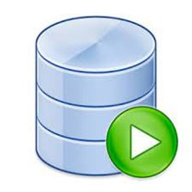



Tech Stack
SQL Agent​

Slide 5
Target Consumers and Competitors
Consumers:
Internal Employees: Employees seeking certifications and professional development.
Managers and Team Leads: Those managing teams and tracking certification progress.
Organizations: The company itself, benefiting from a more skilled and certified workforce.
Current Competitors:
LinkedIn
Stack Overflow
Quora

Slide 6

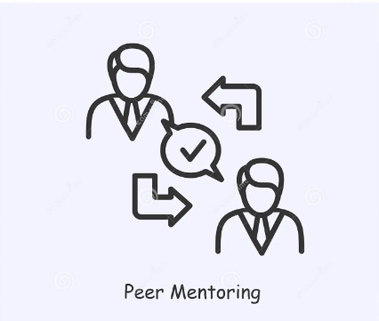



Application Features
Certification Tracking
Mentor Matching
Q&A Forum
Learning Resources
Managerial Oversight

Slide 7
1. Certification Tracking:
The application will enable employees to easily keep tabs on their certifications. They can see which certifications they've completed and which ones they're working towards.
2. Peer Guidance & Mentor Matching:
Employees will be able to connect with their colleagues who have already completed specific certifications. This feature encourages knowledge sharing and mentorship within the organization.
To facilitate guidance, the application will help employees find suitable mentors within the company who can assist them on their certification journey.
3. Q&A Forum:
An interactive Q&A forum will be available for employees to ask questions and seek answers related to certifications. This creates a collaborative environment for problem-solving.
4. Learning Resources:
The application will house a repository of valuable materials and learning paths that employees can access to enhance their certification preparation.
5. Managerial Oversight:
Managers and team leads will have the capability to assign and track the certification progress of their team members, streamlining the certification management process.

Slide 8
Future Scope
Coupons Notifications using Web Scraping:
Reimbursement of Certification Cost
Dashboard for various Metrics
Add a New Certificate to Certificate List
These future scope enhancements aim to further enhance the value and utility of the CertiTrack application, making it a comprehensive platform for certification support, cost savings, and seamless integration into the organization's existing ecosystem.

Slide 9
Coupons Notifications using Web Scraping:
Implement a feature that uses web scraping techniques to gather information about available discounts, promotions, and coupons related to certification exams and training programs.
Notify users within the CertiTrack application about these costs saving opportunities, helping them minimize expenses associated with certifications.
Reimbursement of Certification Cost:
Develop a functionality within CertiTrack to facilitate the reimbursement process for certification costs incurred by employees.
Streamline the reimbursement request submission, approval, and tracking process, ensuring that eligible employees receive financial support for their certification endeavors.
Implement clear policies and guidelines for reimbursement eligibility to manage costs effectively.
Dashboard for various Metrics:
Develop a dashboard to show different type of metrics like no of certifications completed by each employee and his progress.
No of certifications per day/month/quarter/year.
Add a New Certificate to Certificate List:
Allow users to add certificate which is not present in the certificate list and add it when it is approved by the Lead/Approver.
These future scope enhancements aim to further enhance the value and utility of the CertiTrack application, making it a comprehensive platform for certification support, cost savings, and seamless integration into the organization's existing ecosystem.

Slide 10
Contributions and Learnings
Contributions:
Data Collection
Architecture Design
Backend Development (Stored Procedures)
Frontend Development (React)
Key Learnings:
React
GIT Version Control
FastAPI
Effective Collaboration
Problem Solving
Agile Development
Cross-Functional Skills

Slide 11
App Demo & Conclusion
In conclusion, the CertiTrack project is poised to revolutionize how our organization approaches certification management and employee development. By offering a user-friendly web application that tracks certifications, encourages mentorship, and provides valuable resources, we are setting the stage for a more efficient and collaborative environment.
CertiTrack isn't just a tool; it actively encourages positive change. It empowers our internal employees, managers, and the organization as a whole by promoting a culture of knowledge-sharing and growth. As we move forward on this journey, we eagerly anticipate the substantial impact it will have on our employees' career paths and the overall success of our organization. With CertiTrack, we're not merely managing certifications; we're nurturing a thriving learning environment.

Slide 12
Thank You

